Slide 1
Neuralink’s Brain-Computer Interface: Revolutionizing Technology and Raising Ethical Questions
Maria Haddon CSCI-344

Slide 2
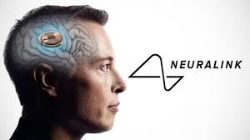
Neuralink is a brain technology company founded by Elon Musk.
Aims to create brain-computer interfaces (BCIs) that allow people with disabilities to control digital devices.
Recent Development: In August 2024, a patient named Alex used a Neuralink implant to play Counter-Strike 2 using only his brain​ (VICE, euronews)
Key Points

Slide 3
Technical Challenges and Ethical Concerns
Earlier trials faced issues, such as electrodes becoming detached in the first patient​ (VICE, euronews)
Alex’s implant has shown improvements with more stability.
Ethical Concerns:
Co-founder Benjamin Rapoport left due to safety concerns regarding the surgical procedures​ (Decrypt).
Animal testing controversy: Over 1,500 animals reportedly died during development​( Decrypt).

Slide 4

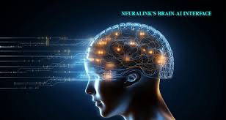
The Road Ahead
Neuralink is developing full digital control, aiming for video game and robotic functionality​
Long-term concerns include privacy and ethical implications of brain-computer integration.
Neuralink has shown incredible potential, but challenges regarding safety and ethics must be addressed​

